Slide 1

PADMABHOOSHAN DR.VASANTRAODADA SHETKARI SHIKSHAN MANDAL’S
PADMABHOOSHAN VASANTRAODADA PATIL INSTITUTE OF TECHNOLOGY,BUDHGAON (SANGLI)
A SYNOPSIS ON
“Farm-mart”
SUBMITTED BY -
Sr. No
1
2
3
4
Name of Student
Prathmesh Sanjay Patil
Aniruddha Rajesh Sawant
Sourabh Sukhadeo Kurne
Sandip Shivaji Sawant
PRN No.
2262691925517
2262691925516
2262691925518
2162691925012
Roll No.
4069
4074
4067
4005
UNDER GUIDANCE OF
Guide name
Madhura. M. Raste.
DEPARTMENT OF CSE (ARTIFICIAL INTELLIGENCE & DATA SCIENCE) ACADEMIC YEAR: 2024-2025

Slide 2
Content
Introduction
Objectives
Methodology used
Use case diagram
Scope
Conclusion

Slide 3
Introduction
we connect buyers and sellers of high-quality livestock across [your location/region]. Whether you're looking to buy or sell cows, buffaloes, or bulls, our platform makes it easy and efficient. We understand the importance of healthy, well-raised animals, which is why we provide detailed listings with information about each animal’s lineage, health status, and location. Plus, we offer a variety of premium feeding foods to ensure your livestock receives the best nutrition

Slide 4
Objectives
Facilitate Seamless Transactions: Create a user-friendly platform that simplifies the process of buying and selling livestock and feeding products.
Provide Comprehensive Listings: Offer detailed information on each animal, including breed, health status, age, and location, to help buyers make informed decisions.
Promote Quality Nutrition: Feature a variety of high-quality feeding foods, including nutritional supplements and balanced grain mixes, to support the health and productivity of livestock.
Connect Local Communities: Foster connections among farmers and ranchers in specific regions by organizing listings by location, making it easier for users to find nearby livestock and resources.
Enhance Knowledge Sharing and Marketing Opportunities: Create a space for farmers to share insights, feedback, etc.

Slide 5
Methodology used
Module 1: Dash Board
Display offers.
Vender available.
Module 2: Supplier login module
Register.
Add/edit/delete livestock animals and feeding products.
Add/ edit/manufacture.
Add/ edit/ delete offers of livestock animals and feeding products.
Display stock.
Feedback.

Slide 6
Methodology used
Module 3: customer user login
Registration.
Search draught animals and feeding products.
Display draught animals and feeding products with shopkeeper.
Add to cart.
Generate bills.
Place order.
Track record.
Feedback.

Slide 7
Methodology used
Module 4: Delivery user login
Registration.
Address details with GPS.
Check order.
Update delivery status.
Get payment.
Module 5: Admin panel
Registration.
Display all reports supplier/customer.
Add/edit/delete Livestock and feeding products.
Add/edit/delete Manufacture.
Automation system.

Slide 8
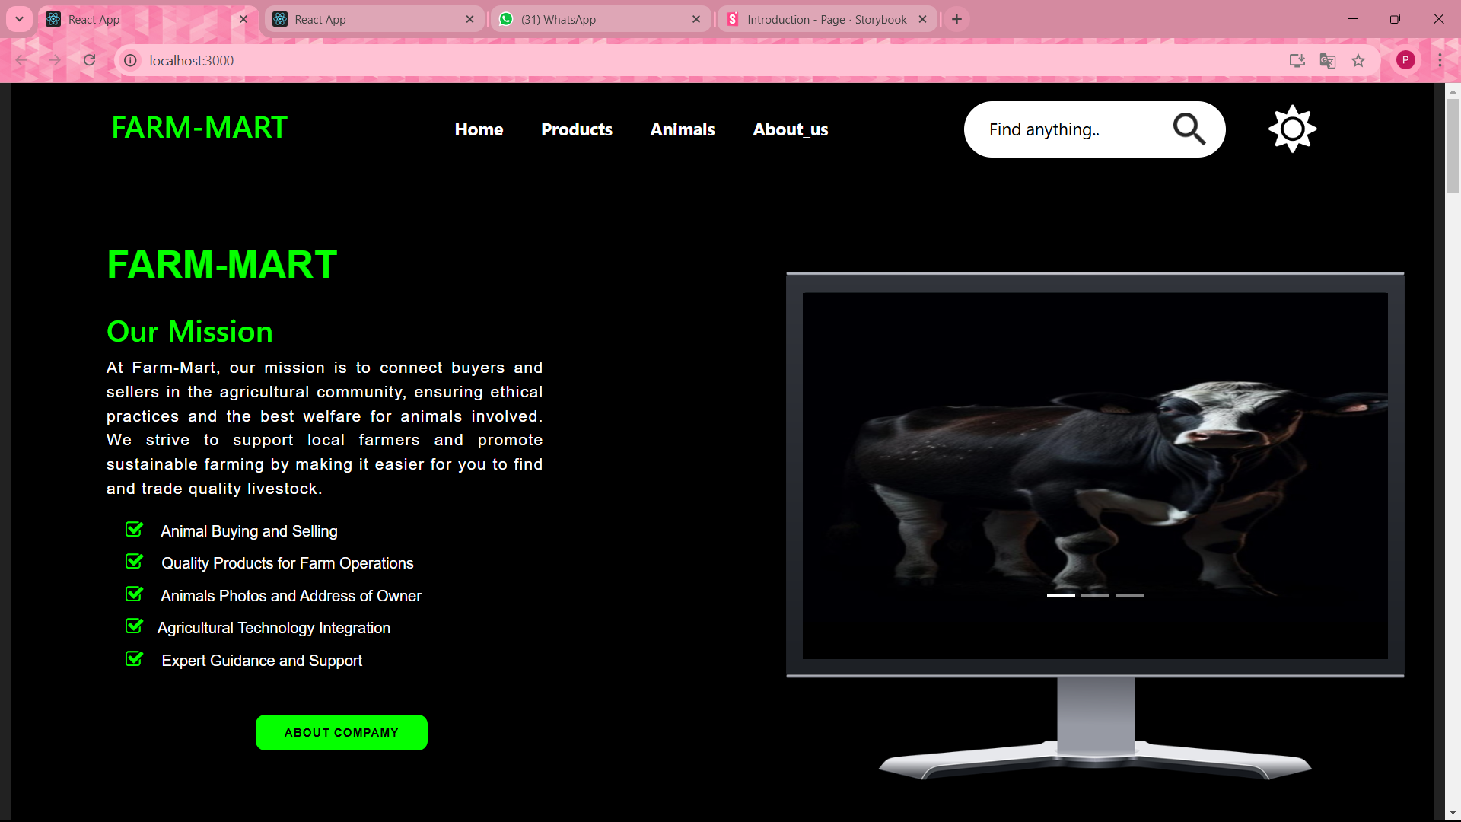
Homepage:- Night Theme

Slide 9
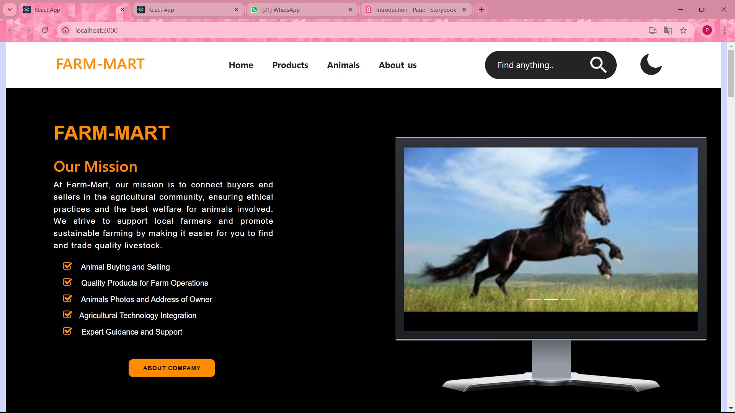
Home page:- Day Theme

Slide 10
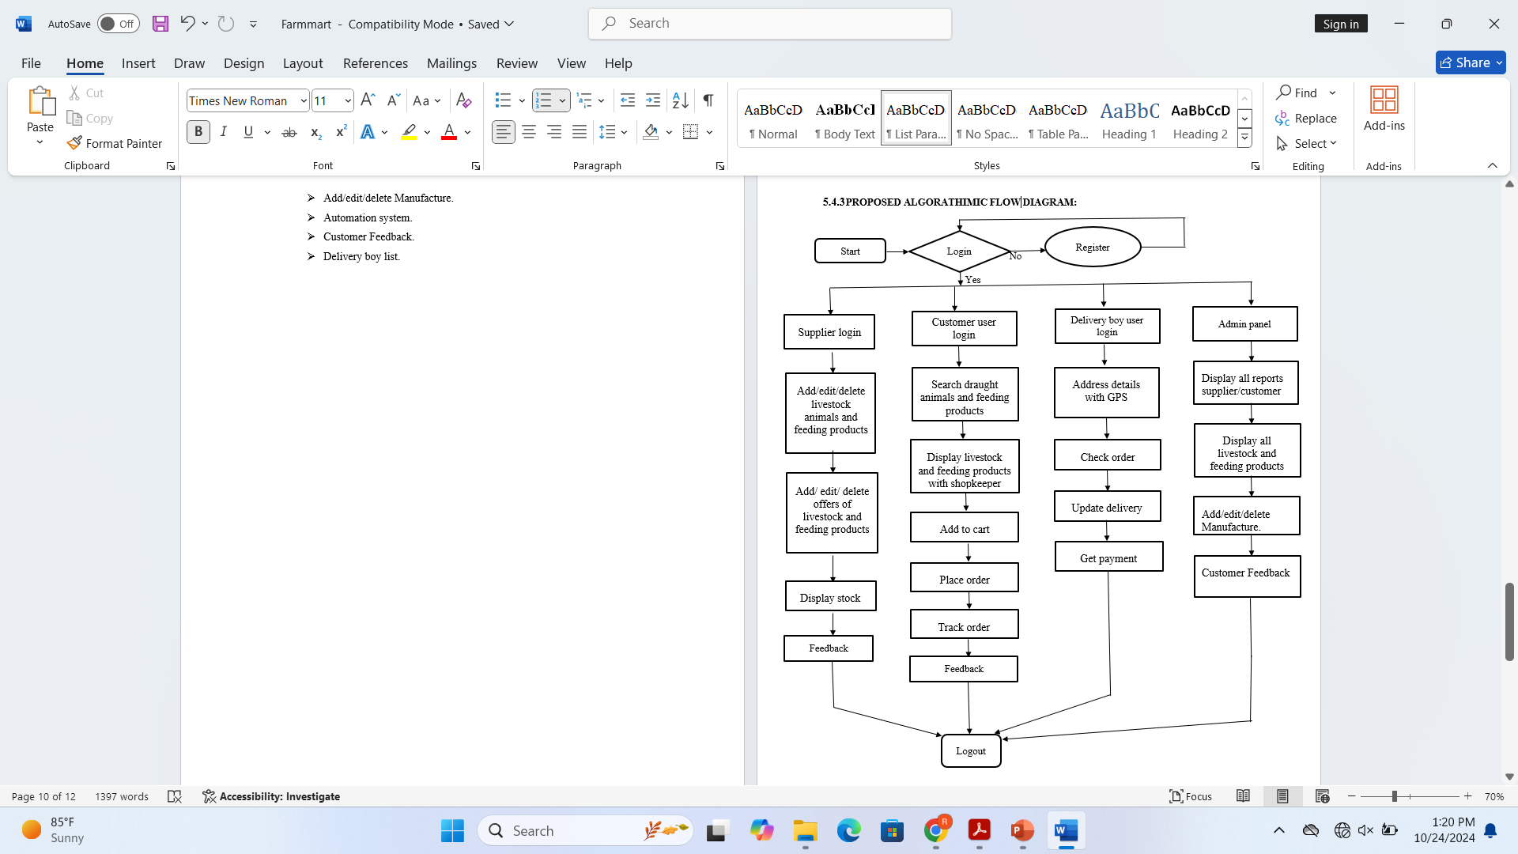
Flow chart

Slide 11
Conclusion
In conclusion, establishing an online platform for selling livestock and feeding products can significantly enhance the accessibility and efficiency of the agricultural marketplace. By leveraging technology, farmers and livestock owners can easily find high-quality animals and nutritional products tailored to their needs.

Slide 12


